Slide 1
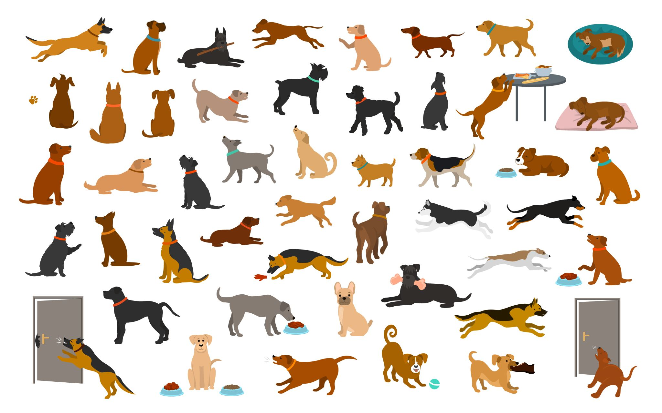
DOG BREED CLASSIFICATION
Authors:
Kandikonda Sai Vikram
Damini Medatati
Sai Keerthi Talapureddy

Slide 2

Problem Description
1. Problem Statement:
To determine the breed of a dog from its image.
2. Data:
Kaggle's dog breed identification competition.
3. Evaluation:
The evaluation consists of a file containing prediction probabilities for each test image's breed.
4. Features:
Info about data: Unstructured images Best to use deep learning/transfer learning.

Slide 3
DATA SET Description
TRAIN DATA & TEST DATA SETS:
Contains the dog images of different breeds.
LABEL DATA SET:
Contains different Dog breed names with respective ID.

Slide 4
DATA PREPROCESSING
Given a large dataset that is difficult to process on local servers, we opted to use Google Colab with its high GPU capability.
To prepare the data for training, we used TensorFlow and its libraries to convert the raw data into numerical representations called Tensors
For image data, we created a preprocessing function that takes an image file path as input, uses TensorFlow to read the file and save it to a variable, then converts the image to Tensors. We also resized the image to a shape of (224, 224) to ensure consistency. The resulting function returns the modified image in Tensor format.

Slide 5
MODEL BUILDING WITH DATA SETS
The model used is a MobileNetV2 model trained on the ImageNet dataset, and it is designed for image classification. The model is pre-trained on a large dataset of images, and it is available for use in TensorFlow through the TensorFlow Hub platform.
We utilized Keras, which is a high-level API that operates on top of TensorFlow. Keras simplifies the implementation of intricate neural networks by providing an easy-to-use framework.
We employed Keras to divide our data into small batches containing different numbers of dog images, such as 32, 100, or 1000.
We then used these batches to train our model consecutively, enabling us to identify the breed of a dog.

Slide 6
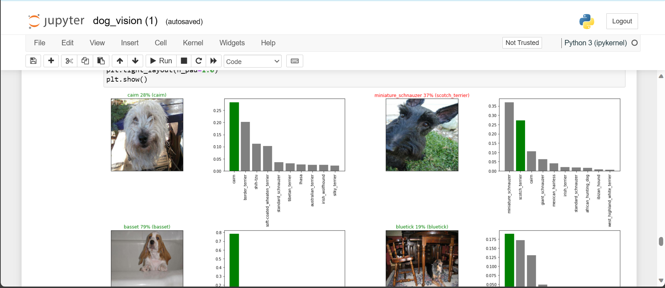
OBSERVATIONS OBTAINED AFTER BUILDING MODEl
The output of our model displays the probability of each dog breed prediction for the respective dog images that were loaded into the model.

Slide 7
Thank You

